Slide 1

70 East Lake Street Suite 1700 Chicago, IL 60601 www.ctbaonline.org
Gentrification and Property Tax Exemptions in the City of Chicago
October 2, 2020

Slide 2
NHS Client Profile
Median annual income of $61,980
$200,000 as the average home value
$2,000 in annual property taxes for a typical NHS client
~1% of home value
Less than 4% of annual income

Slide 3
Longtime Occupant Homeowner Exemption Requirements
10 + years as principal resident or at least 5 years if that person received assistance as part of a government or nonprofit program to purchase the property
Household income of $100,000 or less with:
10% increase for each year after the base year for qualified taxpayers with a household income ranging $75,000-$100,000
7% increase for each year after the base year for qualified taxpayers with a household income of $75,000 or less
The value of the LOHE must be greater than the value of the General Homestead Exemption

Slide 4
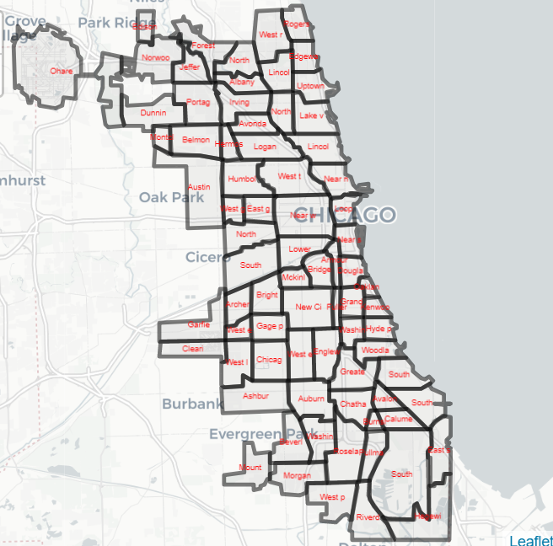
City of Chicago by Community Area

Slide 5
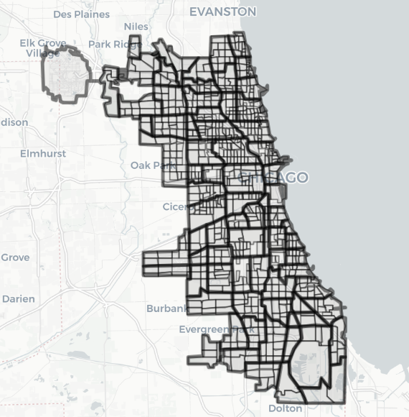
City of Chicago by Census Tract

Slide 6
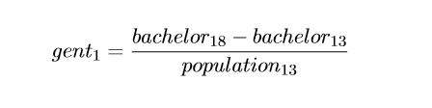
First Gentrification Definition
Restricted for tracts with household incomes below the median in 2013 ($58,676)
Identified tracts that experienced large positive changes (75th and 90th percentiles) in population aged+25 with a Bachelor Degree or Higher
Large positive changes in this variable were strongly correlated with outcomes representative of gentrification

Slide 7
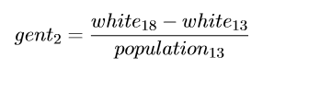
Second Gentrification Definition
Restricted for tracts with household incomes below the median in 2013 ($58,676)
Identified tracts that experienced large positive changes (75th and 90th percentiles) in white non-Latino population
Large positive changes in race demographics similarly correlated with outcomes representative of gentrification

Slide 8
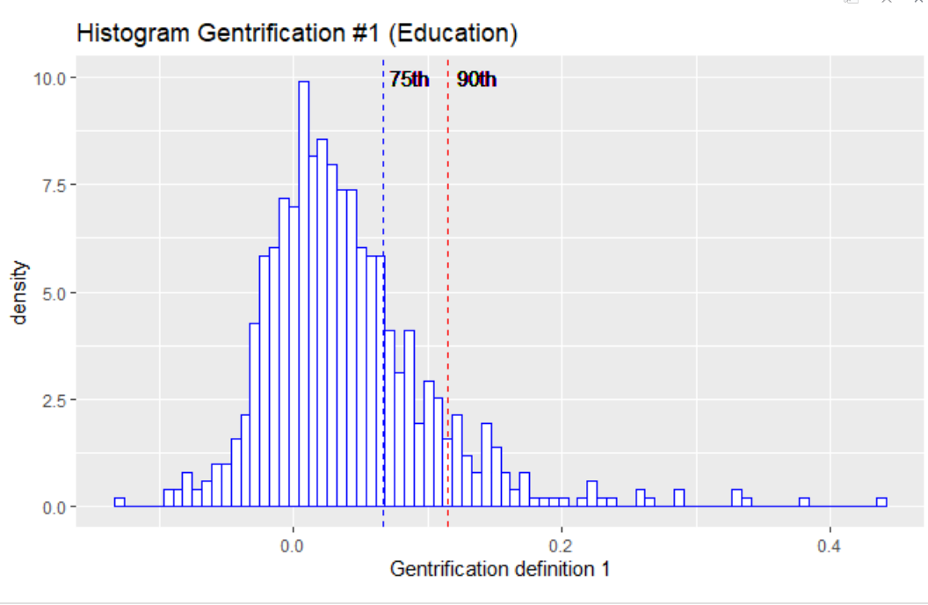
Distribution of Gentrification Definition #1

Slide 9
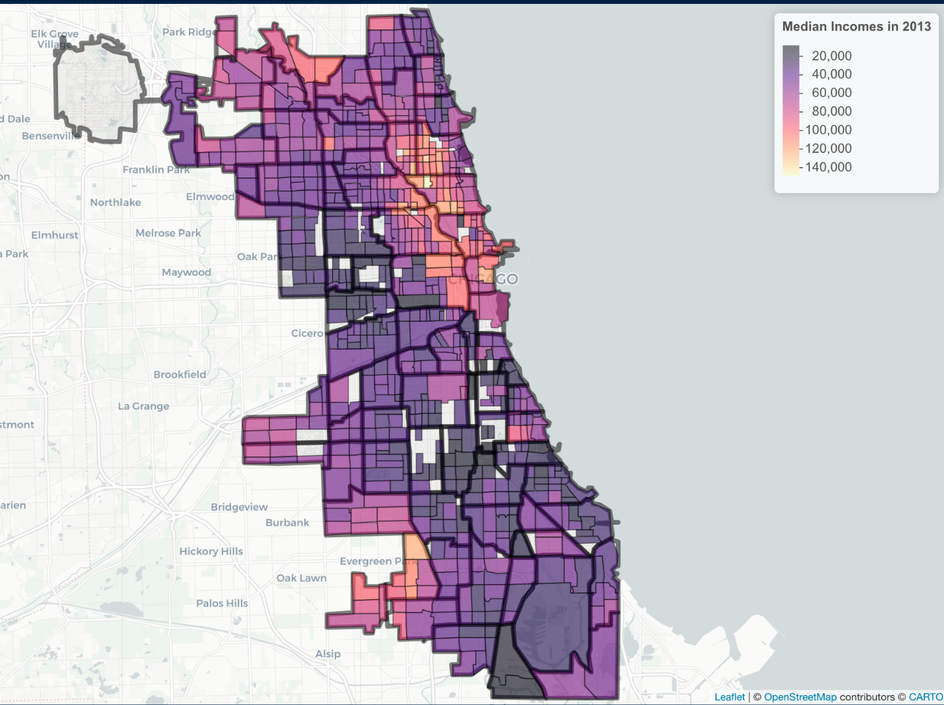
Median Household Income by Tracts (2013)

Slide 10
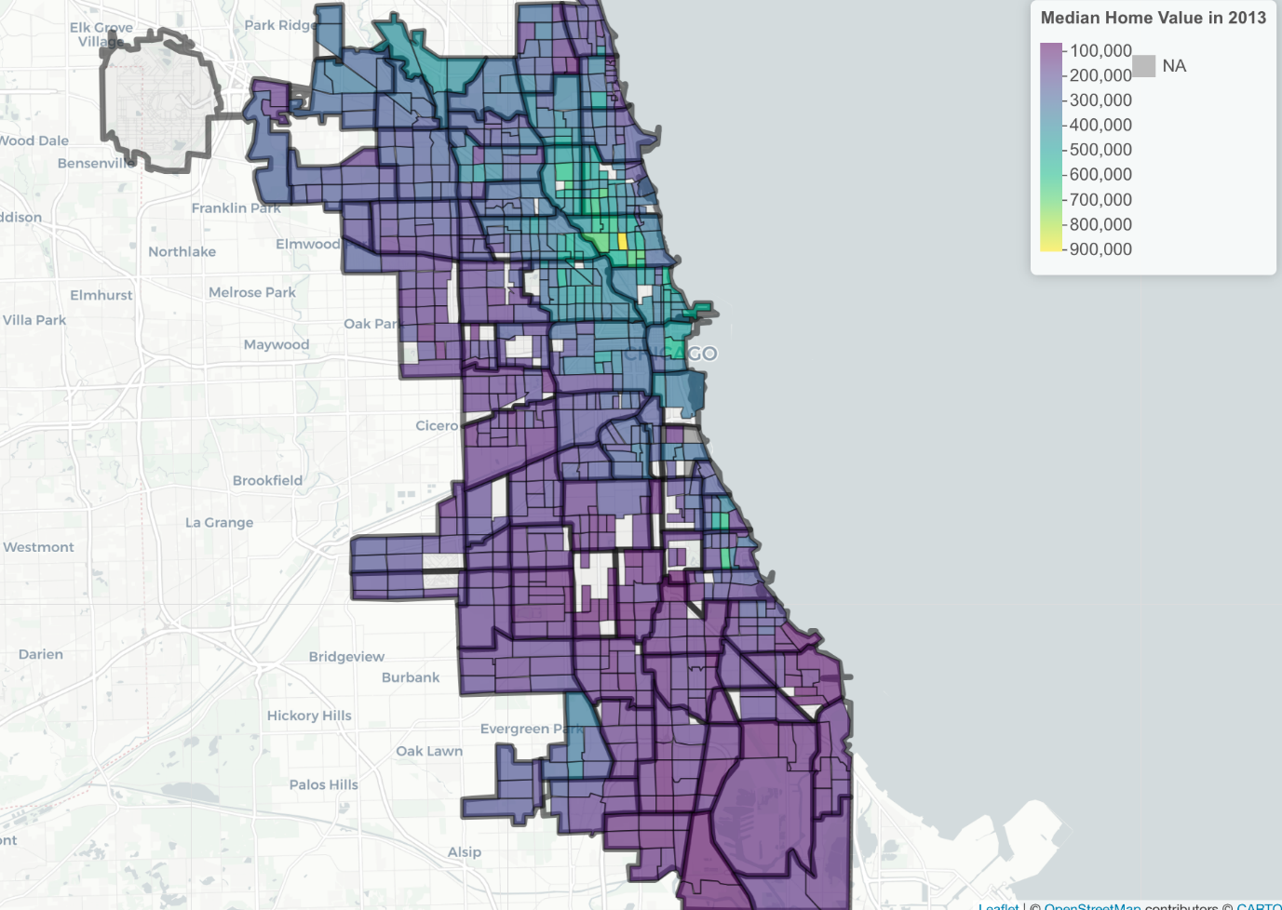
Median Home Value by Tracts (2013)

Slide 11
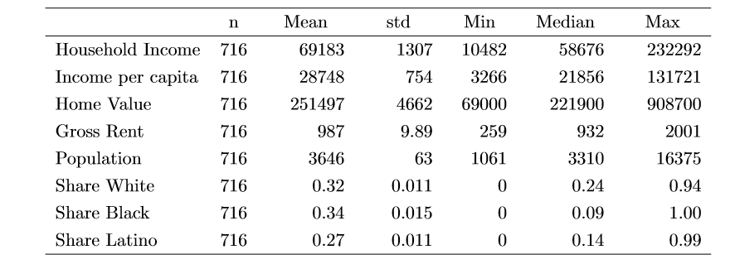
Snapshot of Chicago (2013)

Slide 12
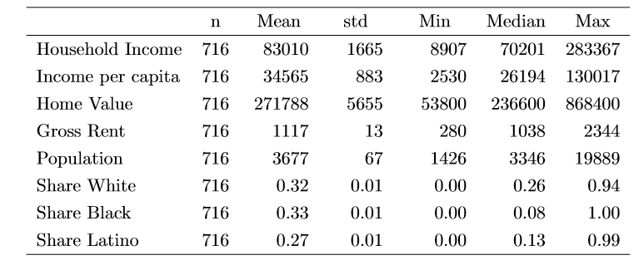
Snapshot of Chicago (2018)

Slide 13
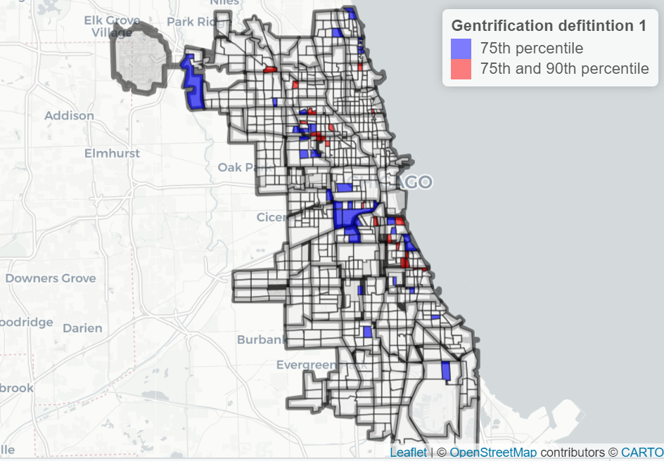
Under Definition #1, Gentrification Clustered in 3 Distinct Areas

Slide 14
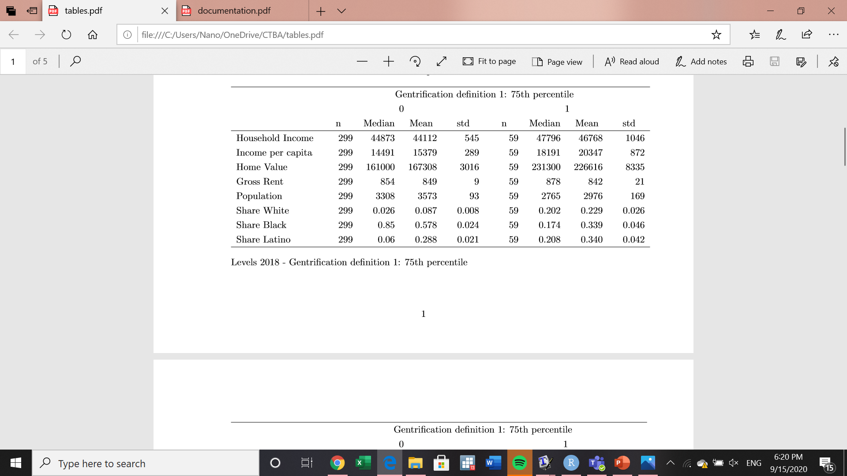
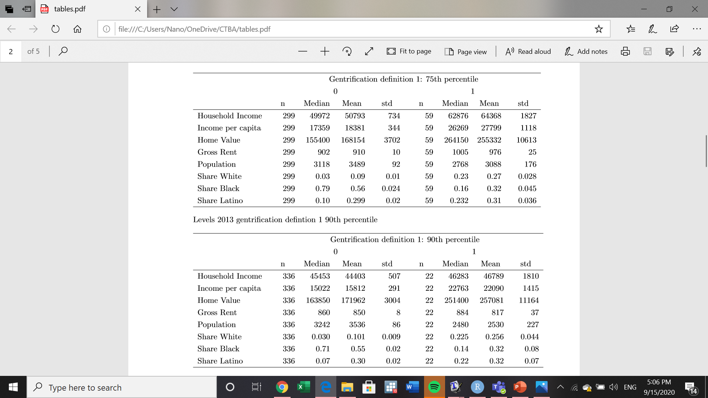
At the 75th percentile, Gentrified Tracts Outpaced Non-Gentrified Tracts
2013
2018

Slide 15
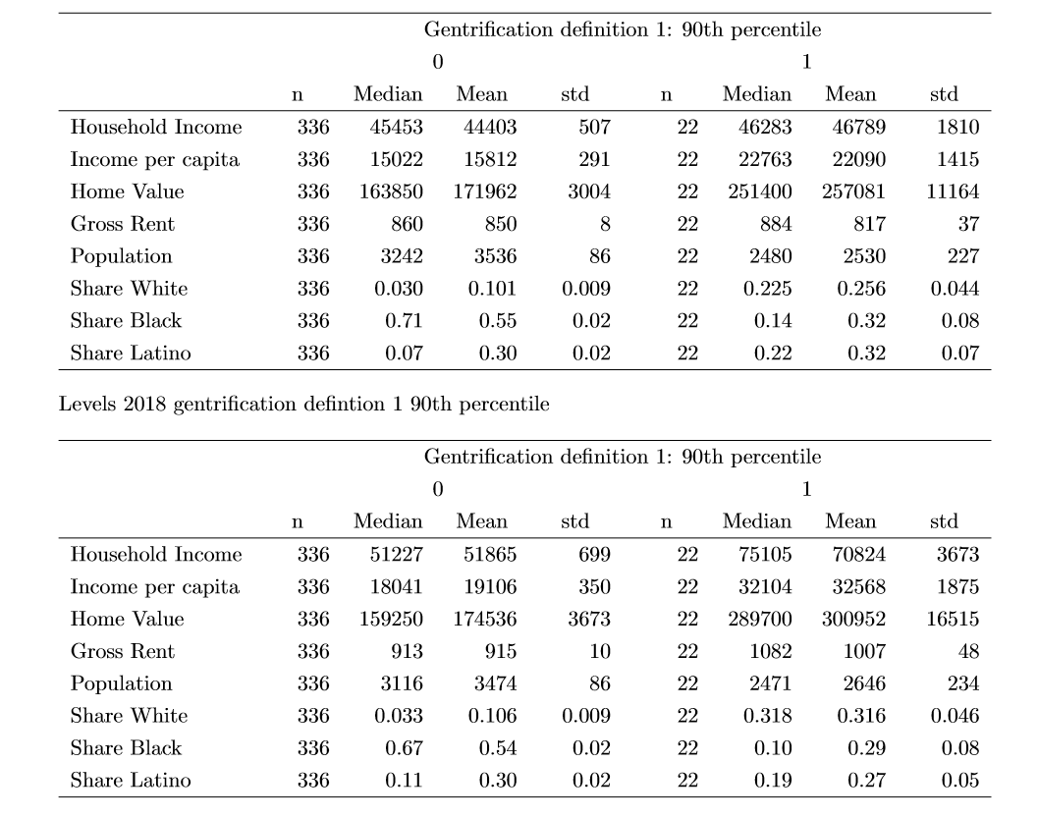
At the 90th percentile, Prior Trends Were Intensified
2013
2018

Slide 16
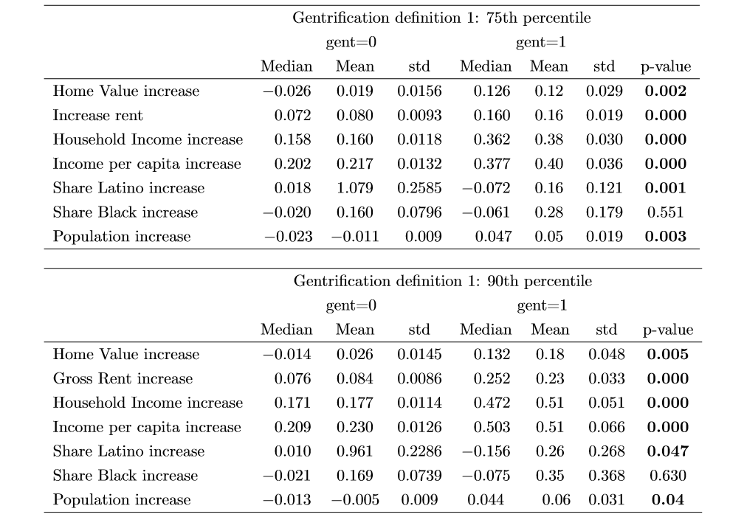
Gentrification Impacts Were
Intense and Statistically Significant

Slide 17
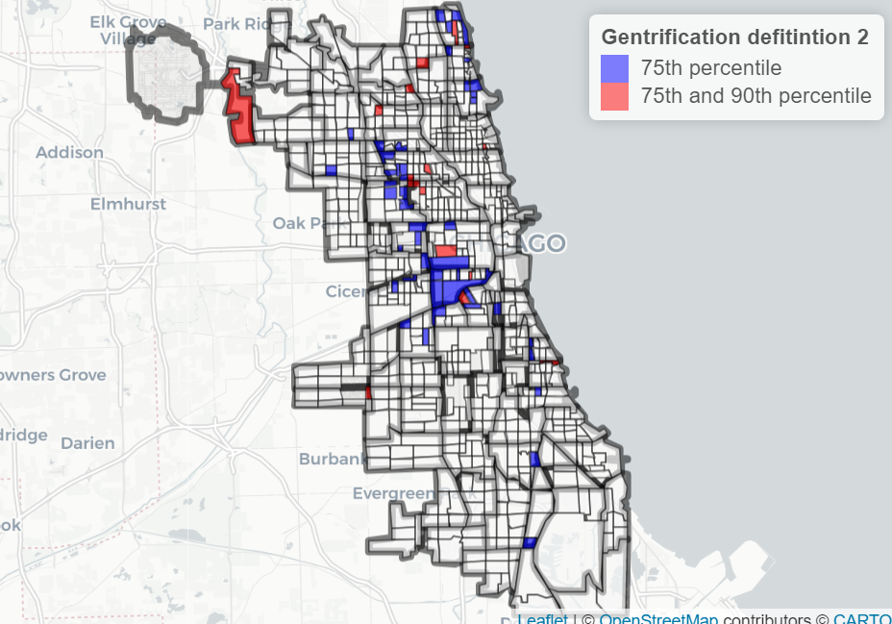
Under Gentrification Definition #2 Similar Clusters Appeared, Barring the South Side

Slide 18

Similar Trends Emerge Under Definition #2
2013
2018

Slide 19
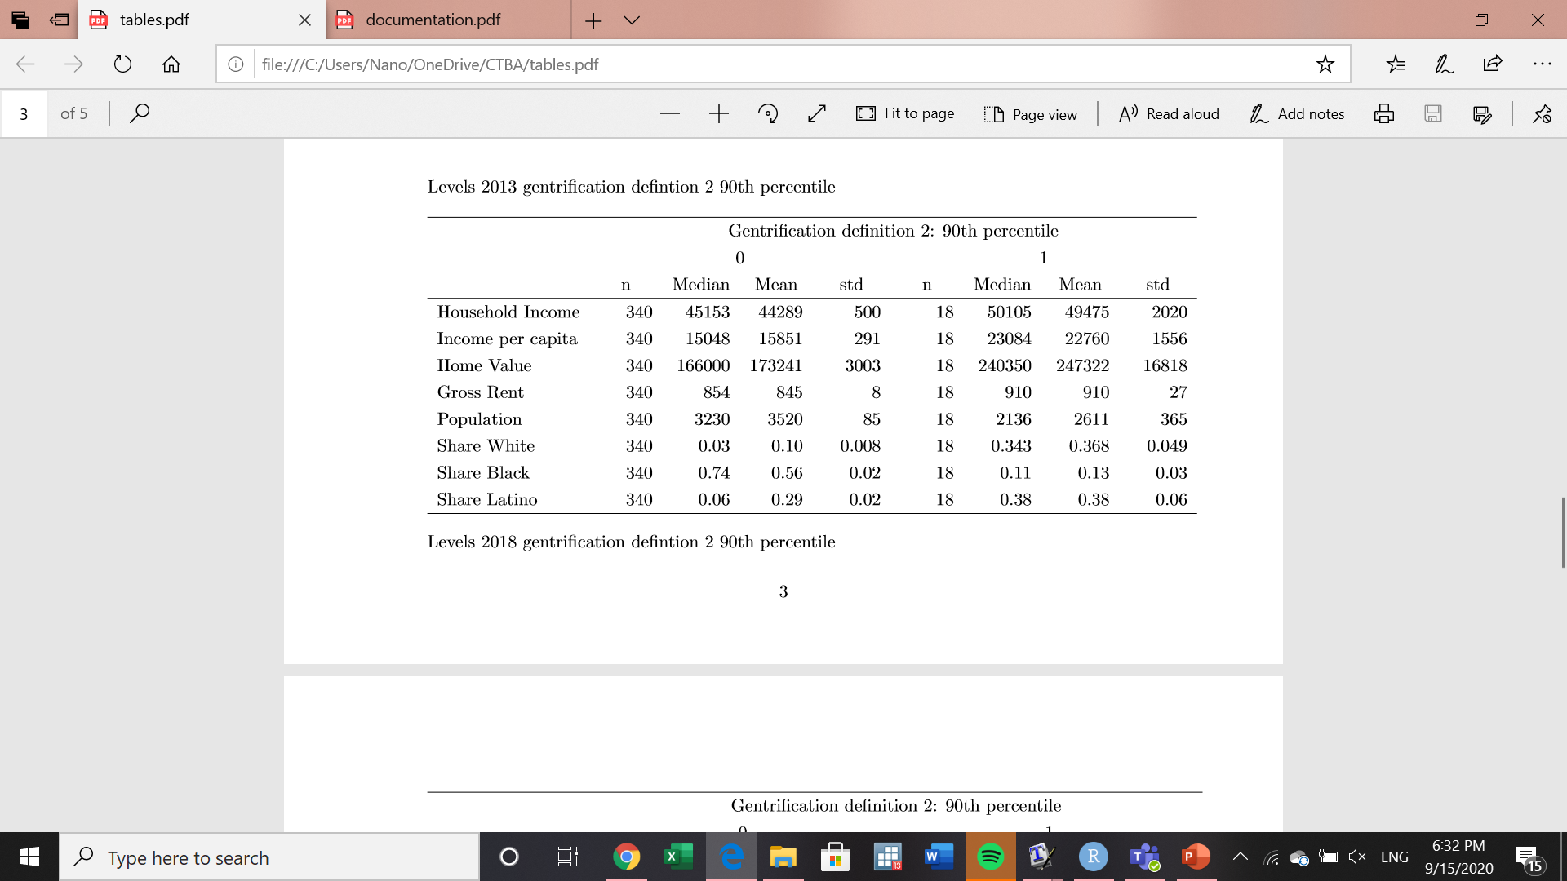
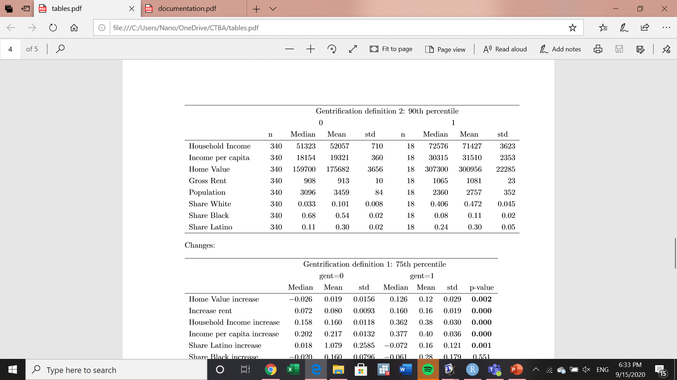
With Similar Growth in Intensity at the 90th Percentile
2013
2018

Slide 20
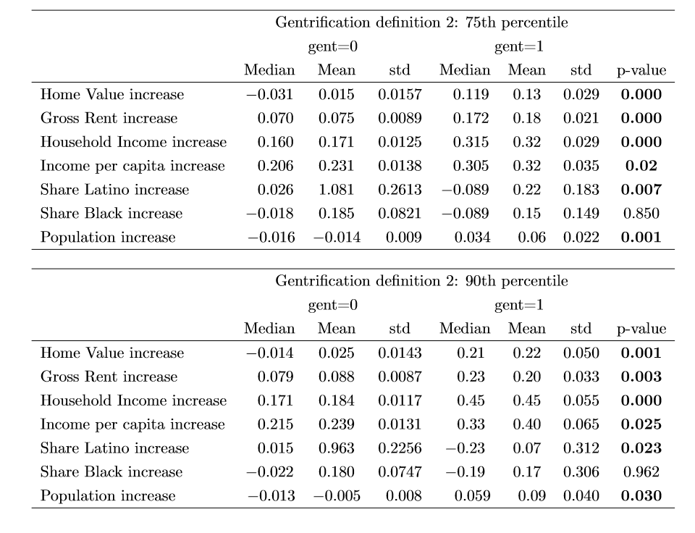
Result Still Retaining Statistical Significance

Slide 21
Characteristics of Gentrifiable Areas
Initially, gentrifiable tracts are typically less populated
More likely to occur in tracts with a higher share of the Latino population
Typically have slightly higher income and home values
Median and mean rents are similar

Slide 22
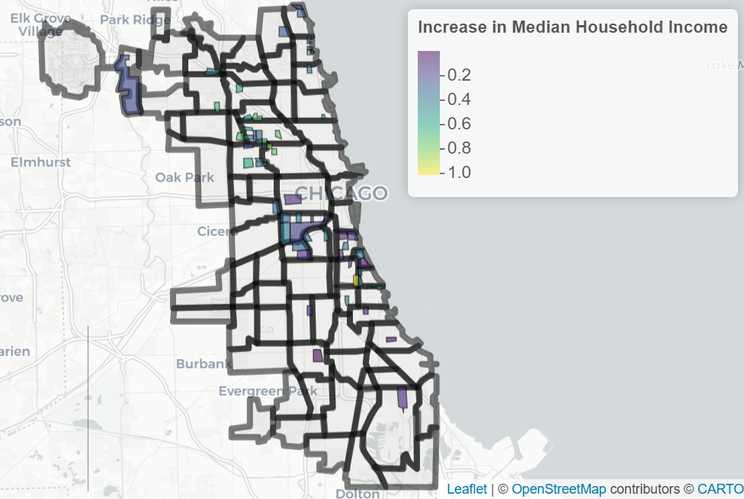
Under Definition #1, Median Household Income Grew Faster In Logan Square

Slide 23
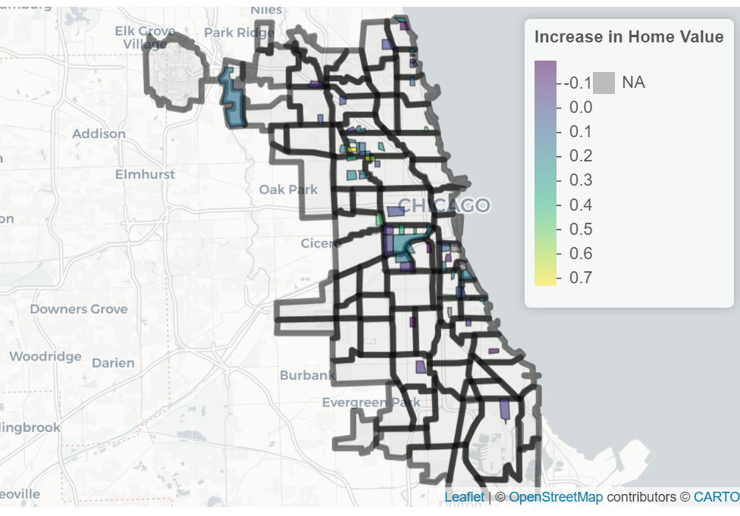
Under Definition #1, Median Home Value Growth Exhibited Similar Trends

Slide 24
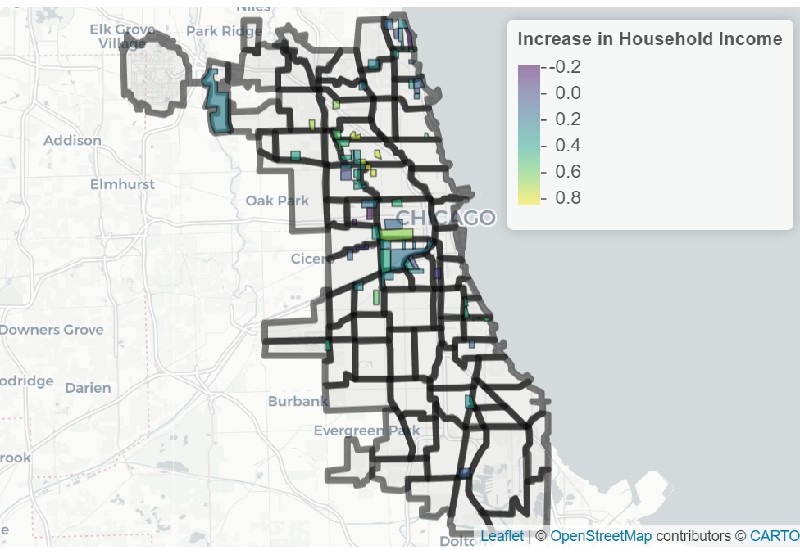
Under Definition #2, Median Household Income Growth Was Varied

Slide 25
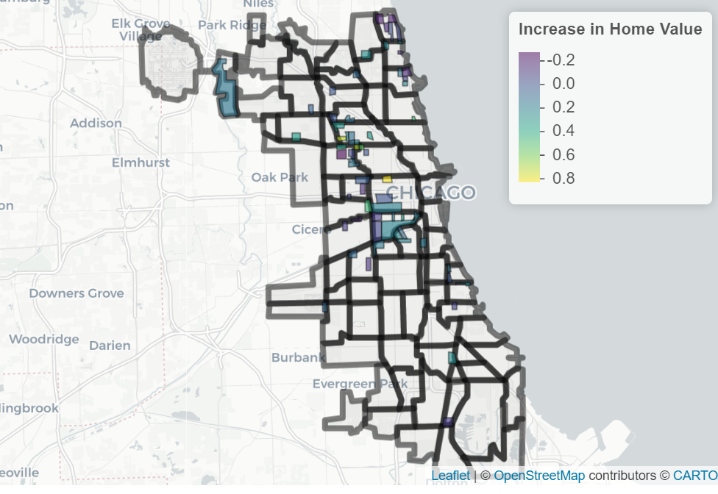
Under Definition #2, Similar Trends Continue

Slide 26
Key Takeaways
Home values, rents, income, and population increase significantly in gentrified tracts
Gentrification occurs mainly in Latino tracts and neighborhoods
Share of black or African American individuals decline in both gentrified and not gentrified tracts
Home values increased between 12% - 22%, and rents increased between 16% - 23% in gentrified tracts between 2013 and 2018

Slide 27
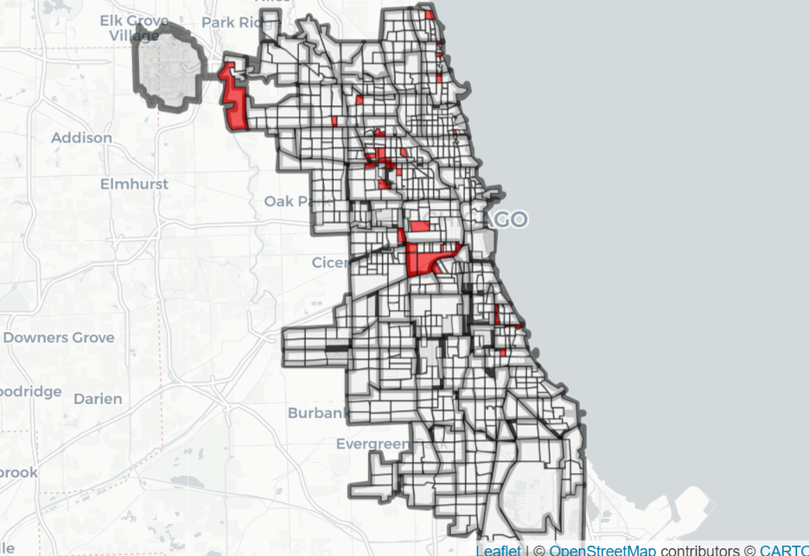
32 Tracts Qualified Under Both Gentrification Definitions

Slide 28
Legislative Challenges
Uniformity Clause
Changes to Cook County Property Tax Exemptions are subject to the uniformity clause
Anything that would specifically be focused on Chicago residents would have to apply to all Cook County residents
General Homestead Exemption’s Effect on South Suburbs
Home Rule Authority
Chicago’s home rule status may limit it to applying a direct exemption to target property tax relief to individuals living in rapidly gentrifying areas

Slide 29
Recommendations for legislation
Changes to Income Requirements
Reduce $100,000 requirement to the Chicago AMI ($81,900 for household size of 3, as of April 2020)
Reduce $75,000 requirement to 80% of the Chicago AMI ($65,550 for household size of 3, as of April 2020)
Changes to Property Value Growth Requirement
Reduce increase in home value requirement from 10% to 5% (26% increase over 5 years)
Reduce increase in home value requirement from 7% to 3% (16% increase over 5 years)
Institute a sliding scale exemption
Fully exempting individuals meeting the requirements
Partially exempting individuals just above the requirements

Slide 30
Recommendations
Request an assessment from the Cook County Assessor’s Office of any changes to the LHE requirements to test impact of any legislative changes

Slide 31
For More Information
Drazzel Feliu
Research Director, Center for Tax and Budget Accountability
(312) 332-2151
dfeliu@ctbaonline.org
Fernando Garcia
Research Intern, Center for Tax and Budget Accountability and
MPP Candidate at Harris School of Public Policy
(312) 866-2886
garciaf@uchicago.edu
.
CTBA's principal goal is to ensure major policy systems work to promote social and economic justice. You can help strengthen our efforts by making a tax-deductible donation at www.ctbaonline.org/donate

